Slide 1
Our Journey
From BS to Best Seng

Slide 2
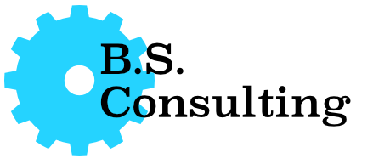
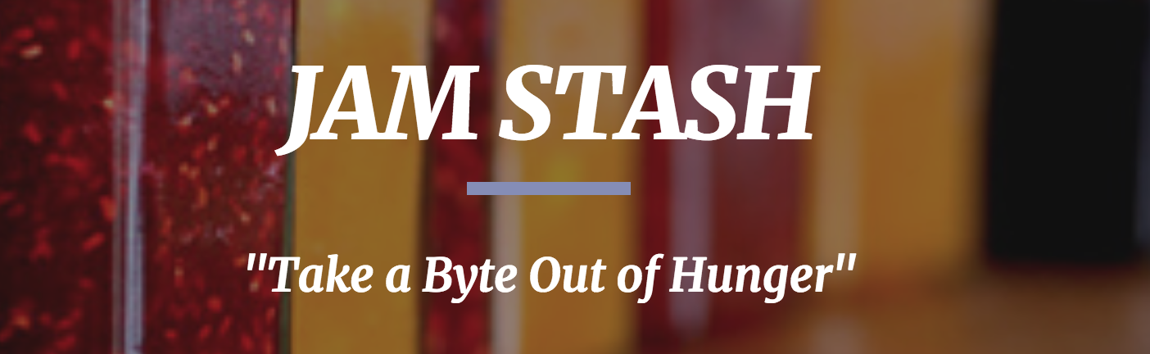
Best Seng Consulting
Our Company: Best Seng Consulting “We make solving your problems our job" | Client: JamStash - UVic Food Bank & Free Store Inventory and Account Management Web App

Slide 3
What We’ll Cover Today
Introduce our team
Our initial thoughts going into the project
RFP
Client Meetings
RD
RSD
A discussion with and about the clients
Final thoughts
Questions from the audience

Slide 4
Our Team
Nathan Conquergood - Use cases and features Scott Goerzen - Editing, storyboards, writing tests and NFR’s Peter Hillar - High-res mockups, domain expert, and introduction Kerui Hu - Client site, features and use-cases | Abdulrahman Mofti - Use cases, introduction and meetings Nicholas Roethel - Requirements, editing and designer site Matt Shipmaker - Diagrams, use cases and meetings Georgia Siemens - Communication, tests and NFR’s

Slide 5
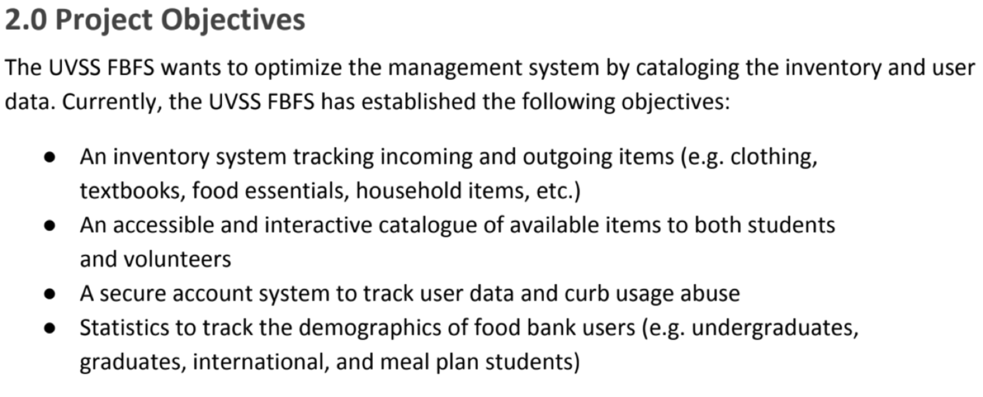
Step 1: RFP

Slide 6
Step 1: RFP
To sum it up:
They wanted a system to keep track of inventory and show available items in store
A way to detect people who abuse the system
A tool to generate statistics report

Slide 7
Looking forward from the beginning
Our assumptions:
We will gather all requirements needed in 2 or 3 client meetings.
Writing a requirements document is EASY! (It’s not)

Slide 8
Client Meetings
Large Groups = Different Pages
Large groups means everyone has different opinions and ideas
It’s important to make sure the whole client team is on the same page or talk to the leader
Take Notes:
Keeps everyone informed/same page
Good for future reference/documentation
Helpful Tips
Make sure everyone is on the same page
Keep a document of questions
Meetings are good for fostering negotiations, and discussing solutions to issues and solving confusion
Notes:
It was good to talk to the client’s allow for easy following negoations to happen.
I did notice having a such a large group created misscommunication inside the group and at times caused people to have different ideas on how a thing should be done.
The client meetings and the formation of the RD, what we learned, what we thought we were doing well

Slide 9
Step 2: RD
Based on the RFP and first client interview we create our first RD
Most of the criterias are GOOD!
Problems returned from RD 1.1:
Weak on explaining management issue and goals to FBFS
Incorrect use of words ‘volunteer’, ‘admin’ and ‘customers’
Misunderstand of user data we need
Lack of access privileges, family aspects
Some inconsistency and ambiguity problems
Fuzzy usage of singular and plural
Some contents are not relevant to the section they are in
Notes:
Helpful tips:
Problem 1~4: Even though we communicate with customer on assigned client interview and through email, is still not quite enough for us.
Problem 5~7: Need to work harder on finding out the Grammatical and word errors. These kinds of errors are like bugs when you coding. When you confidentially finish a program at the very first time, there must be some bugs takes you days to really clean them up.

Slide 10
Step 3: RSD 1.0
We knew the problems from RD 1.1 and how to fix them in the RSD 1.0
We thought we handed in an amazing document, however the results said otherwise
We still had inconsistencies in the document
Some minor such as Uvic vs UVic
Some major such as inconsistencies between the Use Cases, Storyboards and UIs

Slide 11
What we learned from RSD 1.0
We had to all get on the same page
A change in one section meant a change in several others and a small change for you could be a big change for someone else
Overcoming these problems helped with our communication

Slide 12
Step 4: RSD 2.0
How we took everything we learned and created RSD 2.0
Found missing requirements while writing test cases
Small changes can have a large impact
Change a word for consistency then need to update five things
Have not even started implementation
Written Documentation makes Validation much easier
Find and replace is the best

Slide 13
Client’s Thoughts
Working together as clients and designers:
The Good:
Professionalism
Communication
The Challenges:
Not enough negotiation
Final thoughts
Great improvement
Utilized feedback
Notes:
Over the past 3 months, our experience with your group has been generally very positive. As designers, you guys were professional in person and over emails. During the client meetings, your group was well-mannered and easy to talk to. The UI presentation was thoroughly prepared and very well-spoken. Communication was also top-notch. It was always easy to reach out your group should we have any issue. However, there were a few things you could have improved on.

Slide 14
Our Recommendations to the Client
What our client could have done better or differently:
Be more consistent
Communicate more effectively
Try not to explain the solution but rather the problem
What our client did well:
Gave us positive feedback
Pointed out where we were going wrong
Listened well in client meetings

Slide 15
Looking back from the end
What could we have done differently?
Meet with clients more frequently
More in depth elicitation questions
Same people conducting interviews
What did we struggle with?
Consistency throughout entirety of RSD 1.0
Ambiguity in RSD 1.0
What did we do well?
Finalizing RSD 2.0
Team communication
What did we learn?
Consistency is hard
Unambiguity is hard

Slide 16
What We Covered Today
Introduced our team
Our initial thoughts going into the project
RFP
Client Meetings
RD
RSD
A discussion with and about the clients
Final thoughts

Slide 17
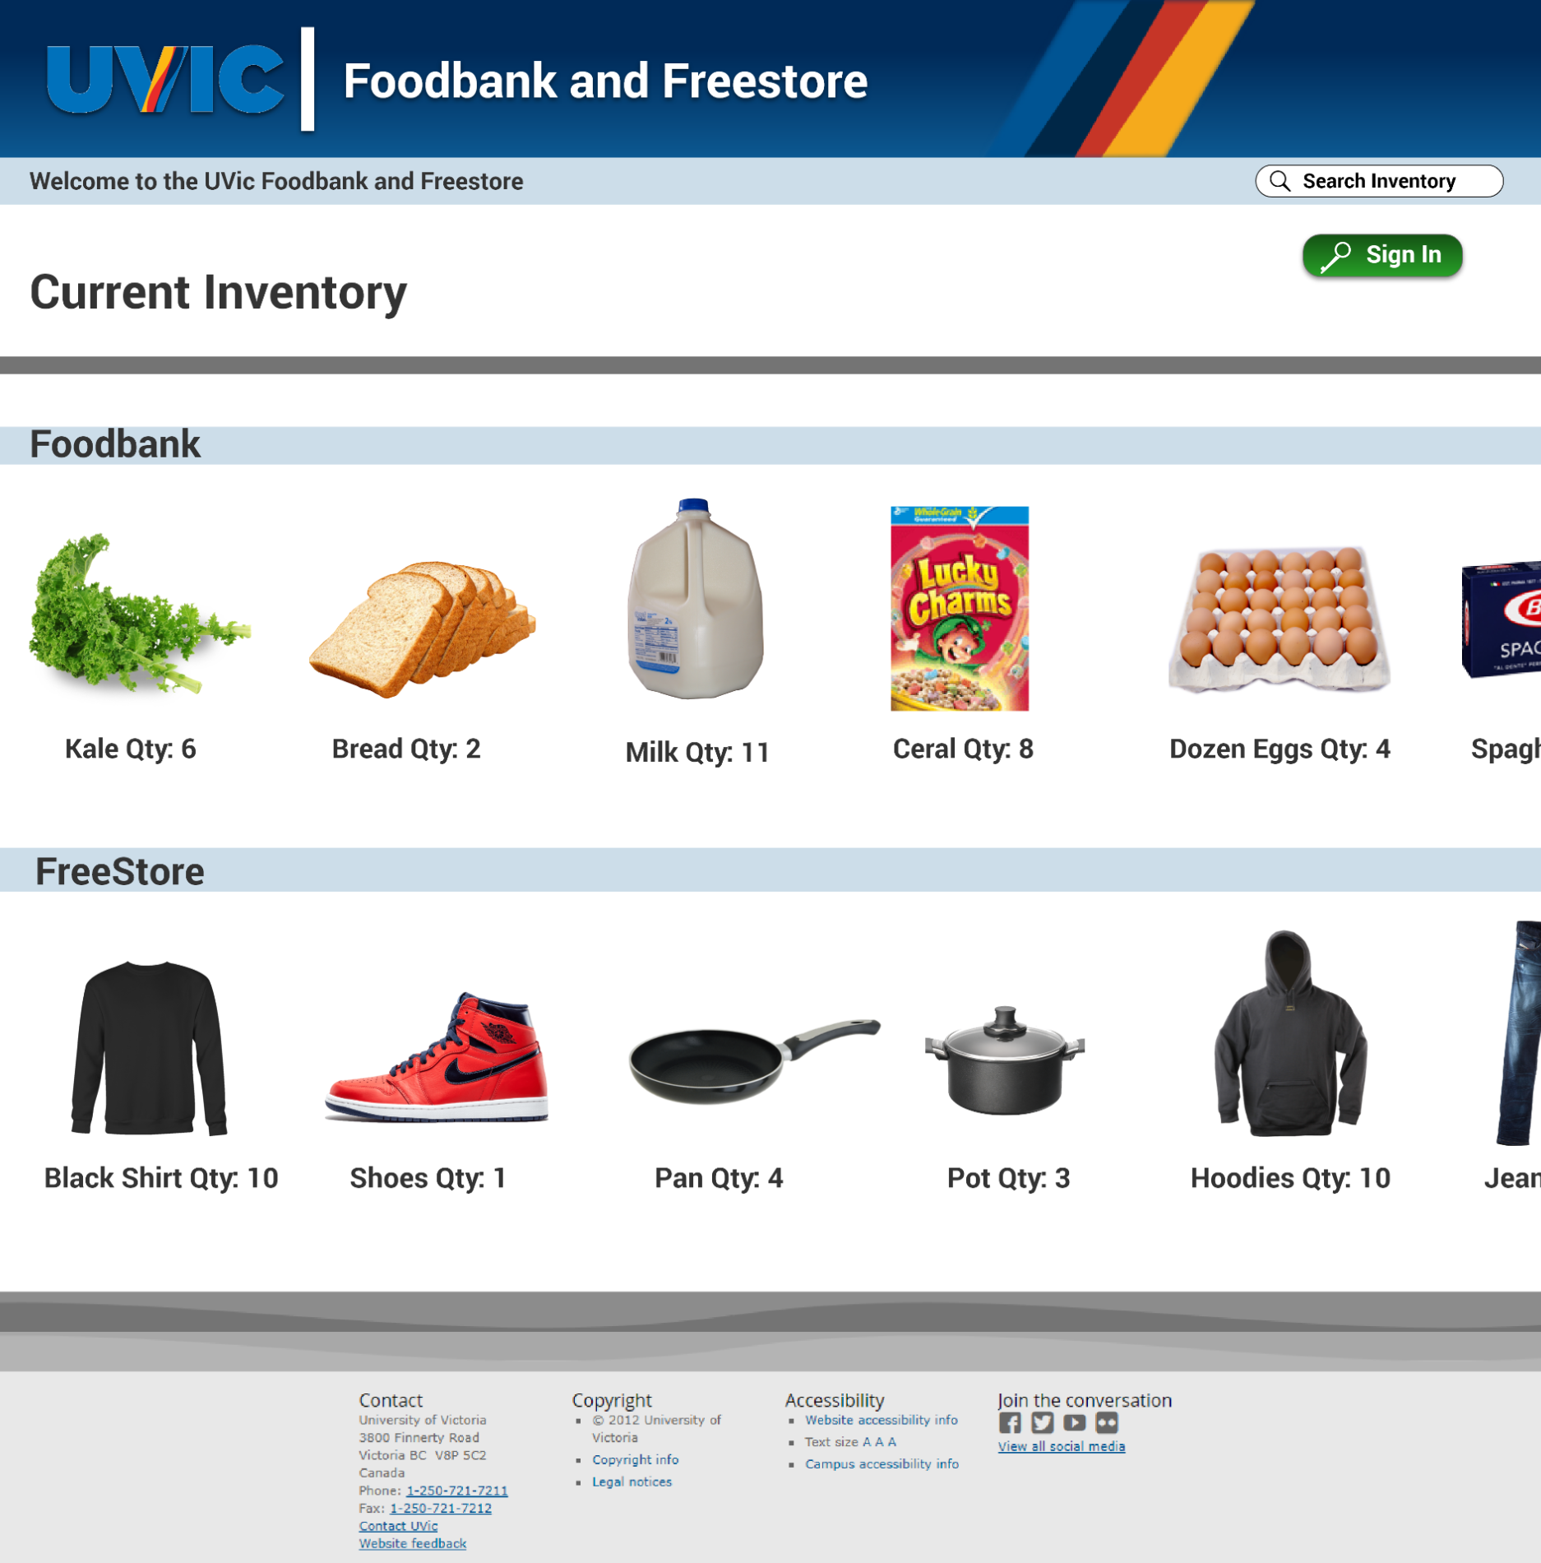

Slide 18
Questions?
Thank you for listening to our presentation.
Does anyone have any questions?

